Slide 1


Exploring Cheonggukjang (CGJ) for Next-Generation Functional Foods: A synergy of artificial intelligence (AI) and experimental approaches
ALESSANDRA MARIE ENCARNACION
RC2 – Center for Food Chemistry and Technology
Ghent University Global Campus
Promoter: Mahta Mirzaei
Co-Promoter: Wesley De Neve
Co-Promoter: Katleen Raes

Slide 2
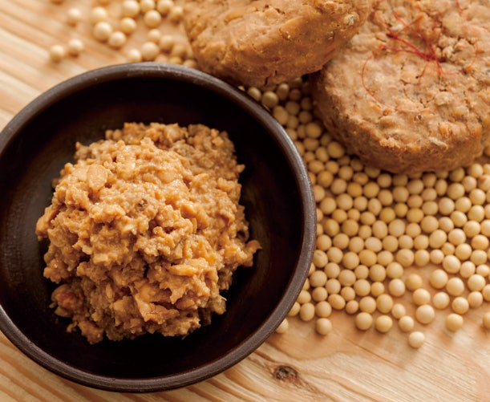
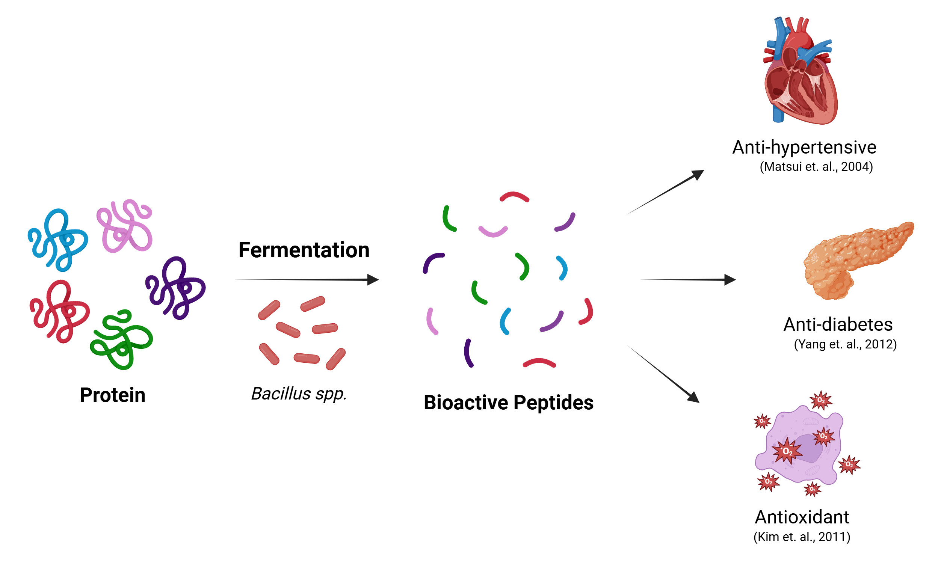
INTRODUCTION
Cheonggukjang (CGJ)
Korean fermented soybean paste; no salt used during fermentation
Fermented by Bacillus species
Rich in protein and peptides
https://onsabo.daesang.co.kr:8443/article/442
WP2 and WP4-related Objective:
(Challenge)
Complex food matrix,
non-specific and variable hydrolysis
Objective (WP2 & 4):
To combine AI and experimental approaches to isolate bioactive peptide(s) with the purpose of acting as a functional food ingredient
Problems of reproducibility
Notes:
Add objectives of the project

Slide 3
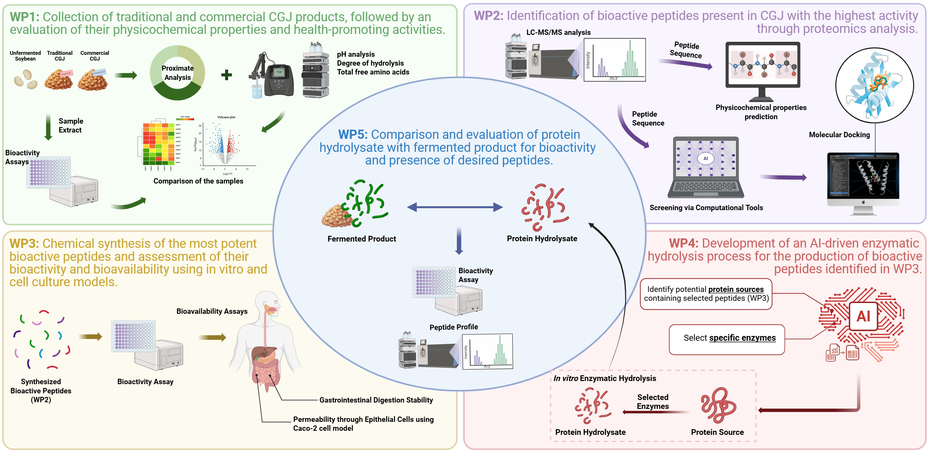
Exploring Cheonggukjang (CGJ) for Next-Generation Functional Foods:
A synergy of artificial intelligence (AI) and experimental approaches

Slide 4
WP2: Identification of bioactive peptides present in CGJ product(s)with the highest activity through proteomics analysis.
Task 2-1. LC/MS-MS analysis of CGJ extract(s) for identification of peptide sequences
Task 2-2. Analysis of peptide sequences for physicochemical properties
Task 2-3. In silico study for screening of peptides with potential desirable bioactivity

Slide 5
WP2: Identification of bioactive peptides present in CGJ product(s)with the highest activity through proteomics analysis.
Task 2-1. LC/MS-MS analysis of CGJ extract(s) for identification of peptide sequences
Biotech Park Scientific https://en.biotech-pack.com/peptidomics.html
  Peptide Identification via Database search–based and De novo sequencing
Yonsei University
  Uses LC-QE (ThermoFischer) for sample analysis
  Uses Proteome Discoverer for peptidomics analysis

Slide 6
WP2: Identification of bioactive peptides present in CGJ product(s)with the highest activity through proteomics analysis.
Task 2-2. Analysis of peptide sequences for physicochemical properties
Expasy Server-ProtParam
2. NovoPro Peptide Property Calculator
3. BERT4Bitter
https://web.expasy.org/protparam/
MW
theoretical pI
amino acid composition
atomic composition
extinction coefficient
estimated half-life
instability index
aliphatic index
grand average of hydropathicity (GRAVY)
https://www.novoprolabs.com/tools/calc_peptide_property
Chemical formula
Molecular weight
Extinction coefficient
Net charge at neutral pH
pI
GRAVY
https://pmlab.pythonanywhere.com/BERT4Bitter
4. HLP
https://webs.iiitd.edu.in/raghava/hlp/
Bitterness
Half-life in intestine-like environment

Slide 7
WP2: Identification of bioactive peptides present in CGJ product(s)with the highest activity through proteomics analysis.
Task 2-3. In silico study for screening of peptides with potential desirable bioactivity
Step 1
PeptideRanker
http://distilldeep.ucd.ie/PeptideRanker/
ToxinPred
https://webs.iiitd.edu.in/raghava/toxinpred/index.html
AlgPred 2.0
https://webs.iiitd.edu.in/raghava/algpred2/
ADMETlab 2.0 https://admet.scbdd.com/home/index/ /admetSAR
https://lmmd.ecust.edu.cn/admetsar1/home/
Step 2
UniDL4BioPep
https://nepc2pvmzy.us-east-1.awsapprunner.com/
CBBL-SKKU peptide prediction tools
https://balalab-skku.org/peptidebased/
CSM-peptides
https://biosig.lab.uq.edu.au/csm_peptides/
pLM4ACE
https://sqzujiduce.us-east-1.awsapprunner.com/
Step 3
HDOCK/PyMol/
AutoDockVina
PDB/AlphaFold
ChemDraw/
PepDraw/MolDraw
LigPlot
Initial Screening
Bioactivity-specific Screening
Molecular Docking

Slide 8
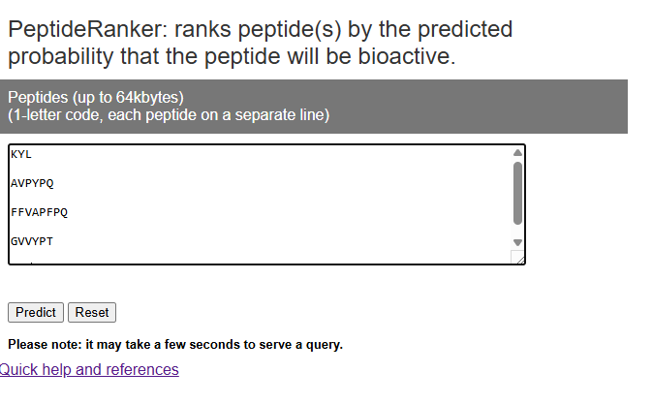
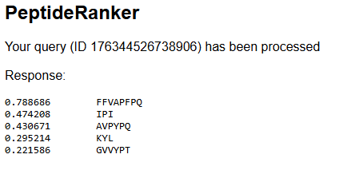

Slide 9
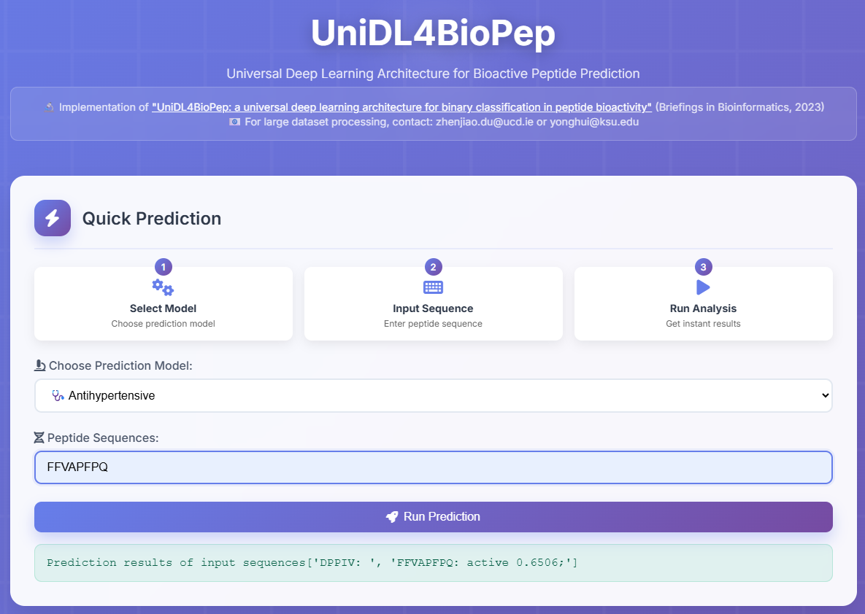
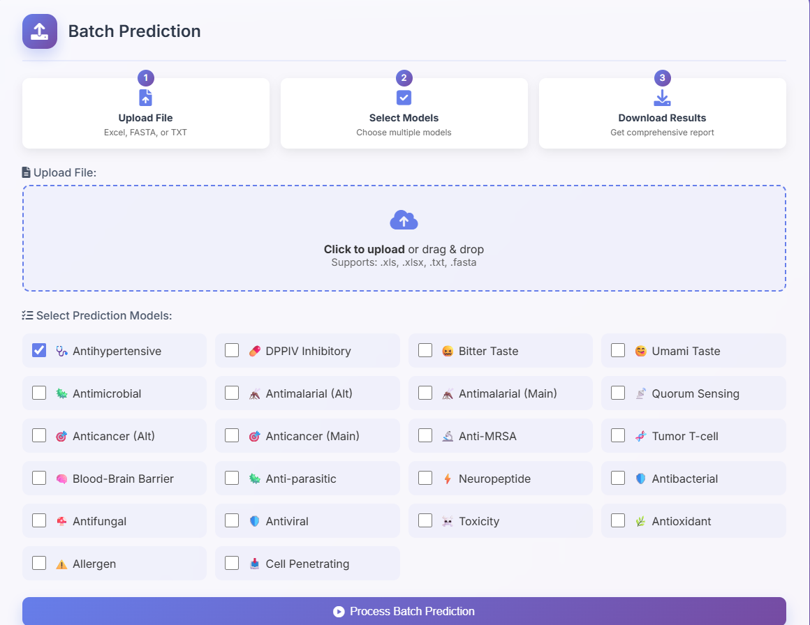
UniDL4BioPep

Slide 10
WP2: Identification of bioactive peptides present in CGJ product(s)with the highest activity through proteomics analysis.
Task 2-3. In silico study for screening of peptides with potential desirable bioactivity
Step 1
PeptideRanker
http://distilldeep.ucd.ie/PeptideRanker/
ToxinPred
https://webs.iiitd.edu.in/raghava/toxinpred/index.html
AlgPred 2.0
https://webs.iiitd.edu.in/raghava/algpred2/
ADMETlab 2.0 https://admet.scbdd.com/home/index/ /admetSAR
https://lmmd.ecust.edu.cn/admetsar1/home/
Step 2
UniDL4BioPep
https://nepc2pvmzy.us-east-1.awsapprunner.com/
CBBL-SKKU peptide prediction tools
https://balalab-skku.org/peptidebased/
CSM-peptides
https://biosig.lab.uq.edu.au/csm_peptides/
pLM4ACE
https://sqzujiduce.us-east-1.awsapprunner.com/
Step 3
HDOCK/PyMol/
AutoDockVina
PDB/AlphaFold
ChemDraw/
PepDraw/MolDraw
LigPlot
Initial Screening
Bioactivity-specific Screening
Molecular Docking

Slide 11
WP4: Development of an AI-driven enzymatic hydrolysis process for the production of bioactive peptides identified in WP3
Task 4-1. Evaluation of various protein sources to identify those containing the target peptides selected in WP3
Task 4-2. Selection of specific enzymes capable of efficiently releasing the desired peptides from the chosen protein sources
Task 4-3. In vitro enzyme hydrolysis process using the protein sources and enzymes selected in Tasks 4-1 and 4-2.

Slide 12
WP4: Development of an AI-driven enzymatic hydrolysis process for the production of bioactive peptides identified in WP3
Task 4-1. Evaluation of various protein sources to identify those containing the target peptides selected in WP3
Method 1: MS analysis software (PEAKS Studio, Proteome Discoverer, etc.)
Peptide mapping soybean proteome using peptide mass spectra;
parameter: non-specific enzyme
Method 2: NCBI-BLAST tool
- Align peptides with soybean proteome database
Method 3: MS-DIAL, FBMN and Cytoscape
- Perform a differential analysis between fermented and non-fermented soybean (like Zhang et. Al., 2025) to determine protein sources by comparing upregulated peptides and soybean proteins

Slide 13
WP4: Development of an AI-driven enzymatic hydrolysis process for the production of bioactive peptides identified in WP3
Task 4-2. Selection of specific enzymes capable of efficiently releasing the desired peptides from the chosen protein sources
Method 1: BIOPEP-UVM Analysis https://biochemia.uwm.edu.pl/biopep/rec_pro1.php?x=98&y=2
Finds the enzyme for peptide release given a specified protein source
Input: peptide and protein sequences in fasta format
Method 2: EnzymePredictor http://bioware.ucd.ie/~enzpred/Enzpred.php
- Similar to Biopep-UVM

Slide 14
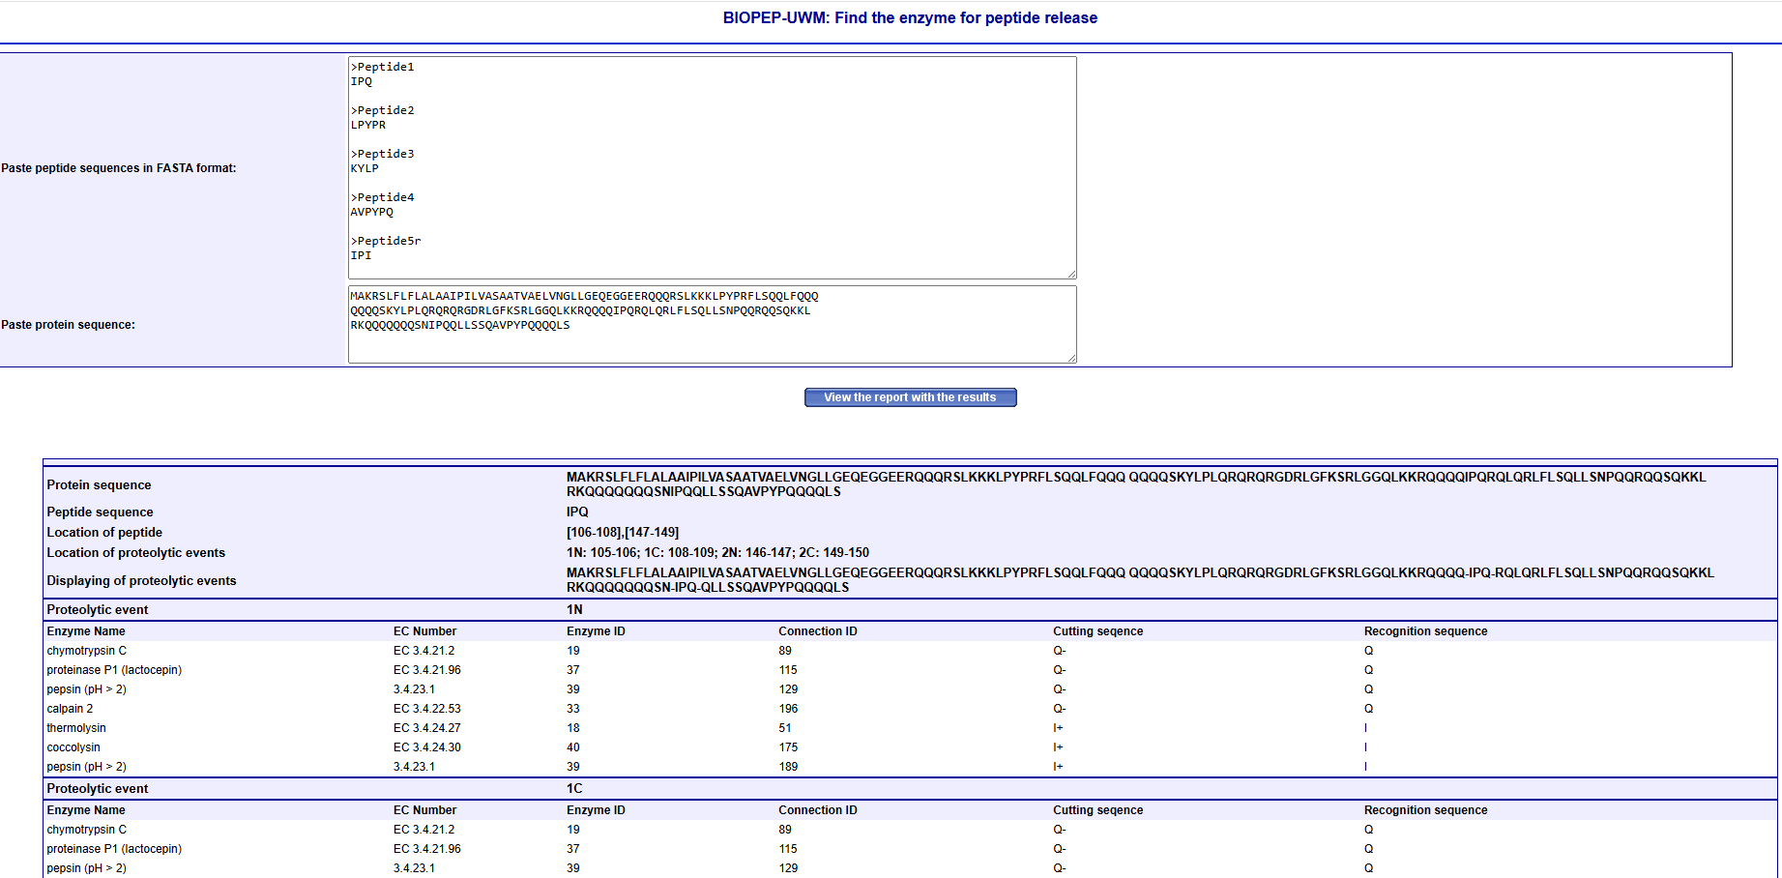

Slide 15
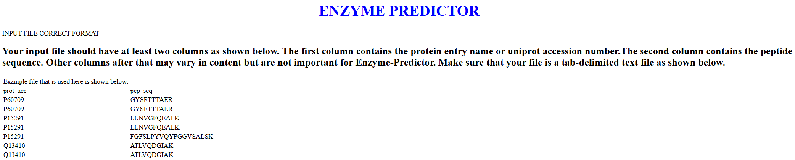

Slide 16
WP4: Development of an AI-driven enzymatic hydrolysis process for the production of bioactive peptides identified in WP3
Other computational tools we could use to validate the AI-driven enzymatic hydrolysis:
PeptideCutter https://web.expasy.org/peptide_cutter/
  Predicts potential cleavage sites
MS-Digest https://prospector.ucsf.edu/prospector/html/instruct/digestman.htm
  Performs an in silico enzymatic digest of one or more proteins and reports the mass of each predicted peptide
Peptigram http://bioware.ucd.ie/peptigram/
  Creates a peptide profile map and peptide alignment map

Slide 17
Thank you for listening! ☺

